Slide 1

Interactive NASA Earth Observation Data Experience
Explore Earth's interconnected systems and the impact of climate change.
by Joel Johnson Kochukoikkal

Slide 2
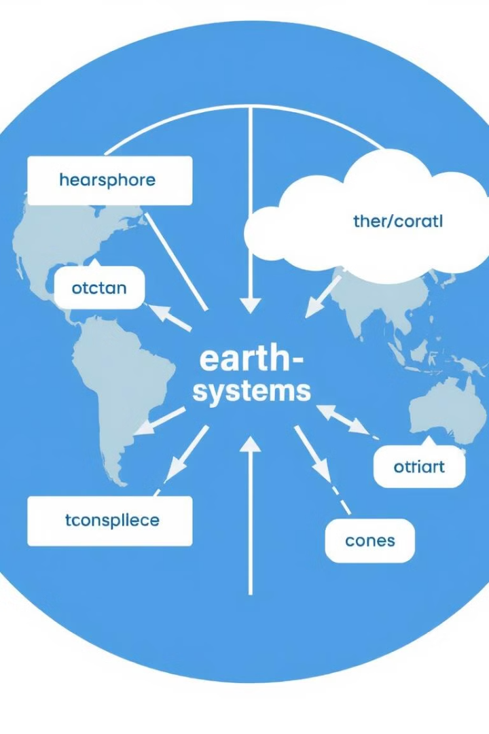
Visualizing Earth's Interconnected Systems
Atmosphere
Oceans
Weather patterns and climate change.
Sea levels, currents, and marine life.
Land
Biodiversity, agriculture, and natural resources.

Slide 3
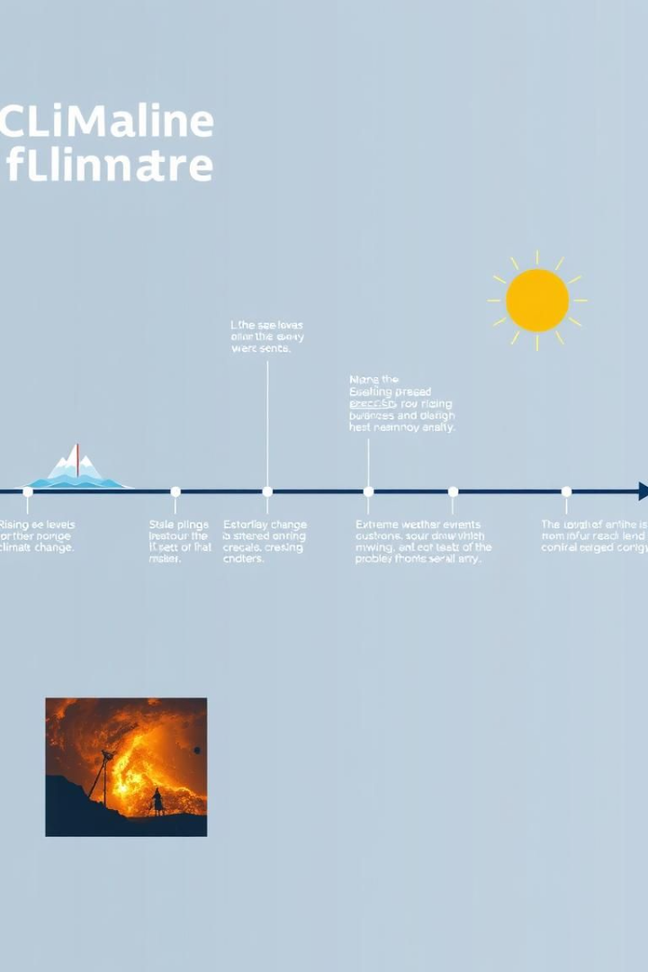
Educating the Public on Climate Change Impacts
1
Rising Temperatures
Heatwaves, melting glaciers, and sea level rise.
2
Extreme Weather
Hurricanes, floods, droughts, and wildfires.
3
Biodiversity Loss
Species extinction, habitat destruction, and ecosystem collapse.

Slide 4
Harnessing NASA's Earth Observation Data
Satellites
Sensors
Models
Continuous monitoring of Earth's systems.
Collecting data on various environmental factors.
Predicting future changes and impacts.

Slide 5
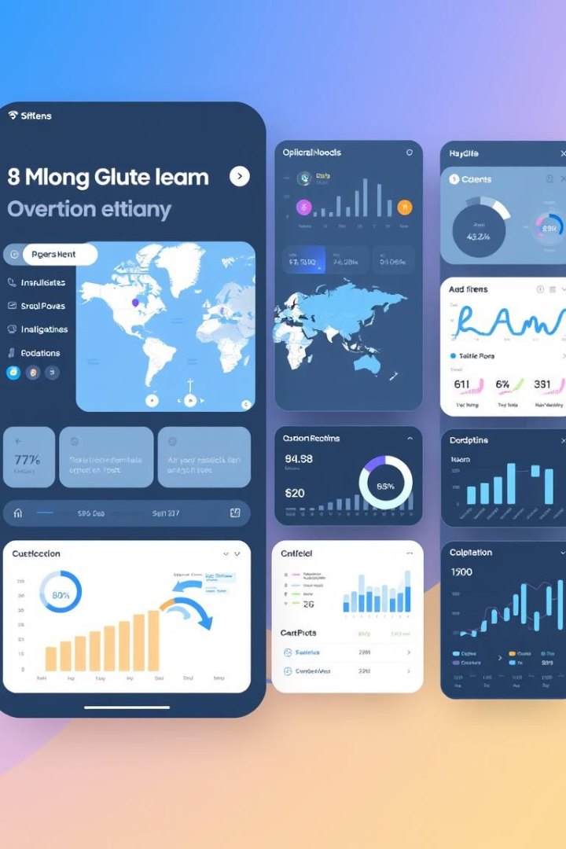



Designing a Visually Engaging Interactive Tool
Data Visualization
Clear and intuitive presentation of data.
Interactive Elements
Allow users to explore data and make connections.
User Experience
Accessible and engaging for a broad audience.

Slide 6
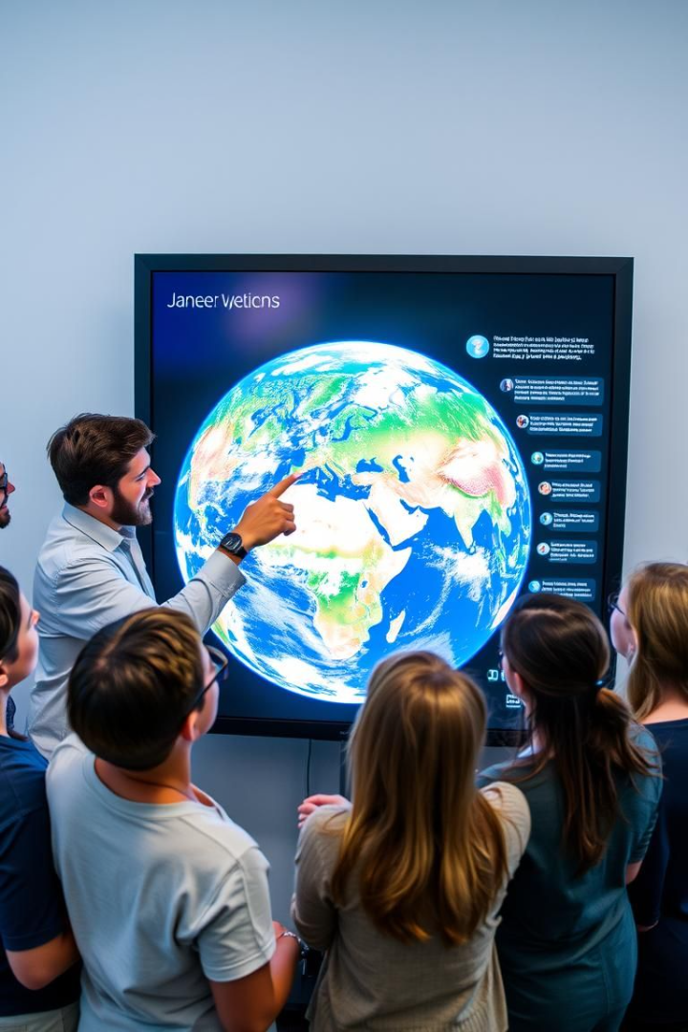

Fostering a Deeper Public Connection with the Earth
Global Perspective
Understanding Earth as a interconnected system.
Environmental Awareness
Recognizing the impact of human actions on the planet.
Inspiration for Action
Motivating individuals to take action for a sustainable future.

Slide 7

Exploring Interactive Formats
1
Web Apps
2
Animations
Accessible and user-friendly interface.
Visually engaging and dynamic storytelling.
3
VR Experiences
Immersive and engaging exploration of Earth's systems.

Slide 8
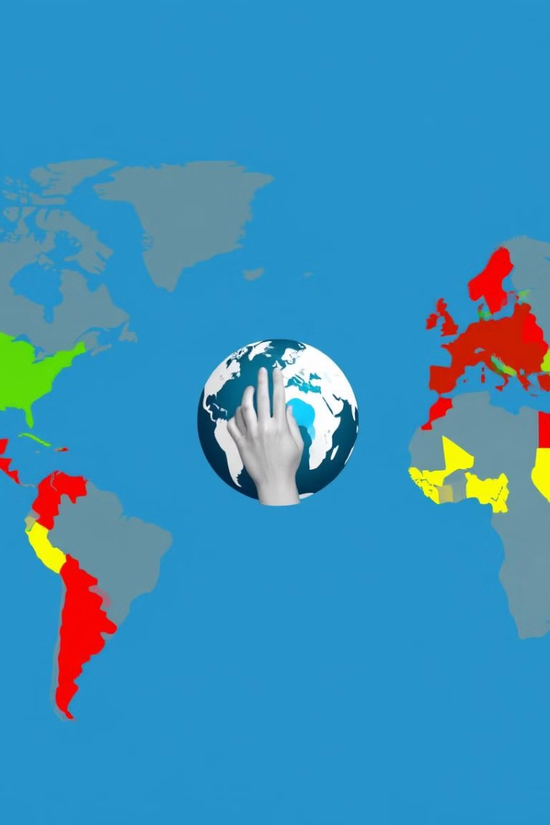
Call to Action: Empowering the Public to Understand and Act
Learn
Share
Act
Explore NASA's data and gain insights into Earth's systems.
Spread awareness about climate change and its impacts.
Make sustainable choices and advocate for change.

